Slide 1
Software Configuration Management
Lecturer: Ngo Huy Bien
Software Engineering Department
Faculty of Information Technology
VNUHCM - University of Science
Ho Chi Minh City, Vietnam
nhbien@fit.hcmus.edu.vn

Slide 2

Objectives
To perform configuration management activities.
To create a configuration management plan.

Slide 3

Contents
Configuration management terminologies
Configuration management activities
Configuration management roles
Configuration management plan
Configuration management solution

Slide 4

References
Jessica Keyes (2004). Software Configuration Management. Auerbach Publications.
Anne Mette Jonassen Hass (2002). Configuration Management Principles and Practice. Addison Wesley.
Roger S. Pressman (2010). Software Engineering : A Practitioner’s Approach.
Susan A. Dart (1992). The Past, Present, and Future of Configuration Management.

Slide 5
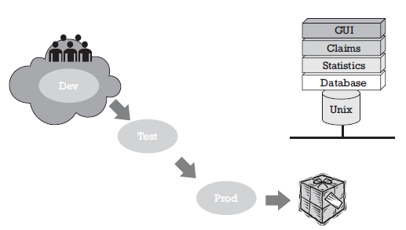
First Year

Slide 6
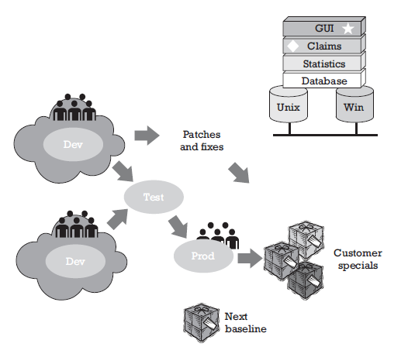
Second Year

Slide 7
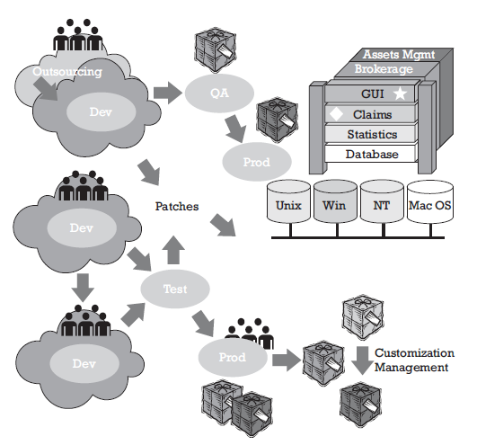
Third Year

Slide 8
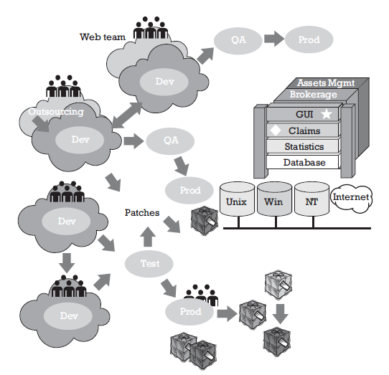

Fourth Year
Software systems are very complex.

Slide 9
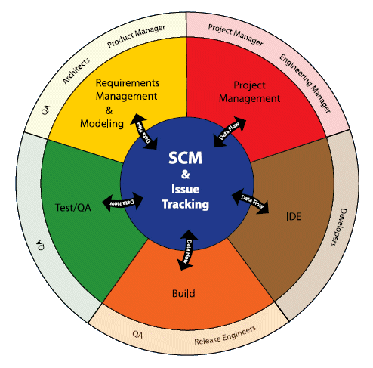
Creating a Release
Project vision
Statement of work
Project schedule
Resource list
Specs
System design
Visual studio
MS Visio
MS Word
NUnit
Test plan
Test report
Source code, setup package

Slide 10


Slide 11
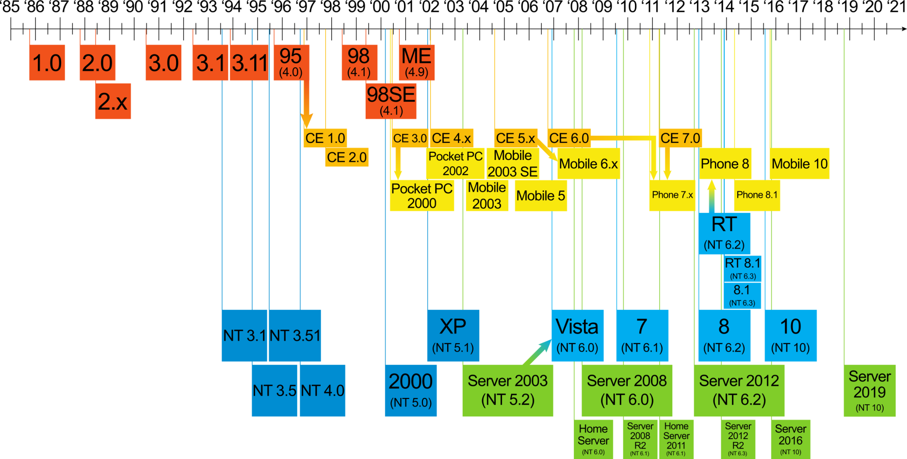
What is CM? [1]
Software configuration management (SCM, or just plain CM) is an organizational framework — that is, a discipline — for managing the evolution of computer systems throughout all stages of systems development.

Slide 12
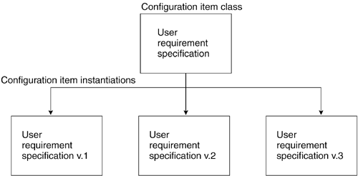

Configuration Item [2]
A configuration item is any possible part of the development or delivery of a system or product that it's necessary to identify, produce, store, use, and change individually.
Configuration Item Class
Instantiations
The Life of a Configuration Item Class

Slide 13
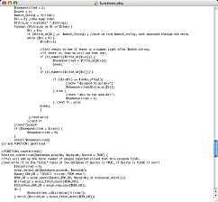

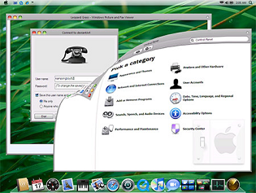
Electronic Objects
An unlimited number of copies may be easily produced.
Copies may be in either electronic or physical form.
It must be stored electronically.

Slide 14
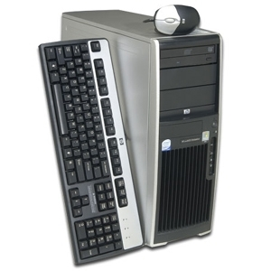
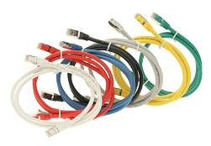
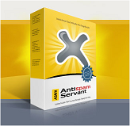
Physical Objects
It cannot be stored on a computer but must be stored in a physical place.
When a copy of the object is delivered, the number of available copies is reduced.
Most traditional configuration management tools cannot handle a physical object without a proxy-object in electronic form.

Slide 15
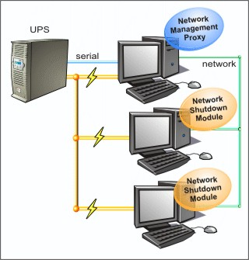

Objects of a Product
Procedure descriptions, service agreements or contracts, training material (computer-assisted training material, teacher's manual, slides) or user manuals.
Hardware – Network

Slide 16
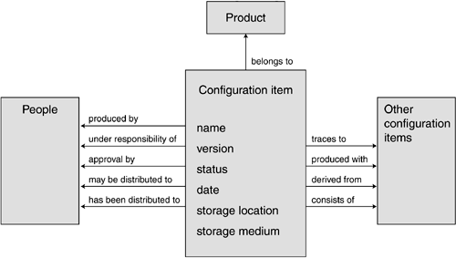
Configuration Item Metadata [2]
Metadata for Authorization
Metadata for Relations to Other Configuration Items
Metadata for Distribution
Metadata for Unique Identification

Slide 17
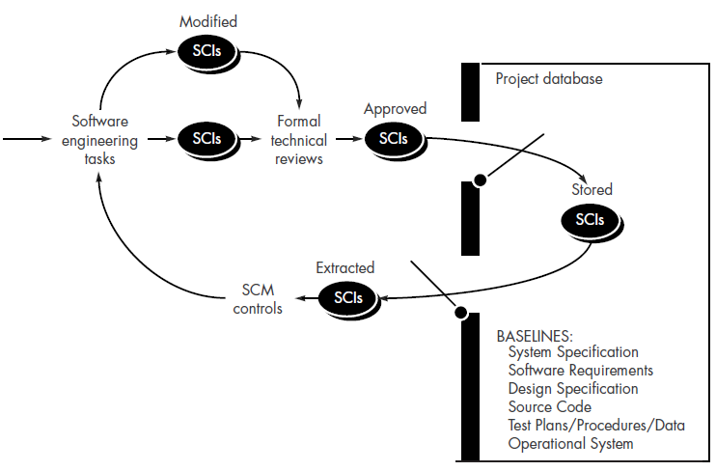
Baseline [3]
A specification or product that has been formally reviewed and agreed upon, that thereafter serves as the basis for further development, and that can be changed only through formal change control procedures.

Slide 18
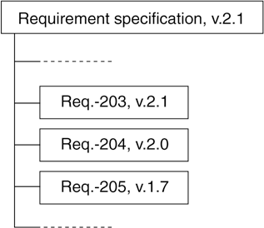
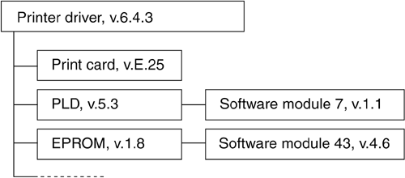
Deliveries [2]
Deliveries are hierarchies of configuration items and may be constructed of other deliveries in a ramified hierarchy.
Hardware-Related Delivery
Requirement Specification Delivery

Slide 19
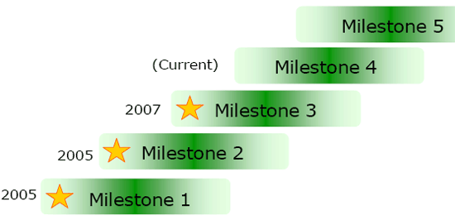
Milestone
A milestone is a specific point with a specified outcome.
Milestones are used to track progress toward a specific goal or event.
Included CIs | 01/10/2011 | 03/15/2011 | 04/30/2011 | 06/30/2011
Project plan | 1.0 | 3.0 | 4.1 | 4.1
Requirement specification | 1.0 | 1.3 | 1.6 | 1.6
Architectural design | — | 1.2 | 1.3 | 1.3
Detailed design | — | 1.0 | 1.2 | 1.3
User manual | — | — | 1.1 | 1.1
Complete system | — | — | 1.0 | 1.1
Release note | — | — | — | 1.0
A dash indicates that the configuration item is not part of the delivery.

Slide 20
Release
A software release is the distribution of an initial or upgraded version of a computer software product. For example, executable program, documentation, release notes, and configuration data.
Release To Marketing,
Manufacture
Pre-Alpha
Alpha
Beta
Release candidate
Gold
Techinal Previews
TP
RTM
CTP
GA
Community Technology Previews
General Availability

Slide 22

Learning at Home
Read slides
→ Focus on tools and systems.
→ Register accounts.
→ Prepare slides and artifacts based on your project.
→ Make a presentation.

Slide 23

Discussion Questions
Baselines (Main Artifacts / Products) → ??.
File Name: Vietnamese / English → ??.
Directory Structure → ??.
Communication Tools → ??.
Tracking Tools → ??.
Build Automation → ??.
Continuous Integration: Source code → Emails/SMS
Continuous Delivery: Source code →👤 | (Yes) → URL (Heroku), Emails/SMS → ??
Continuous Deployment: Source code → URL (Heroku), Emails/SMS → ??
Changes: Informal Process / Informal Procedure, Status Reporting → ??.
Releases → Audit → ??.
Backup → ??.

Slide 25

Configuration Management Activities

Slide 26
1. Identify Configuration Items
Plans
Identification
CIs
Products delivered to the customer
Designated internal work products
Acquired products
Tools and other capital assets of the project’s work environment
Other items used in creating and describing these work products
Hardware
Software
Product Source Code
Documents

Slide 27
2. Assign Unique Identifiers to CIs
<SYSTEM>[<TLA>]_[<SUBSYSTEM>]_[<TLA>]_[R|A|B]<X>[.<Y>.<Z>][.BL<#>]
PLN | Project Plans
SOW | State Of Work
USC | Use Cases
SRD | Software Requirements Document
SDD | Software Design Document
SRC | Source Code Files
TSP | Test Plan
R|A|B | Stand for release, alpha, or beta
<X> | Integer, stands for a major release (e.g. 1)
<Y> | Integer (optional), stands for a minor release
<Z> | Integer (optional), stands for an alternative release (patches, ports, etc.)
BL | Stands for base level (an internal release)
# | Integer, for internal releases
Windows_PLN_B1.0
Windows_IE_USC_R3.5
Windows_R7.0 Source Code?

Slide 28

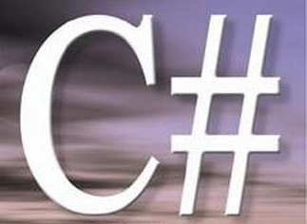



3. Specify the Important Characteristics of CIs
file type
programming language
author
when to control
reponsible people

Slide 29

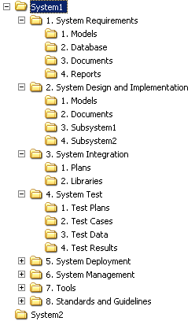
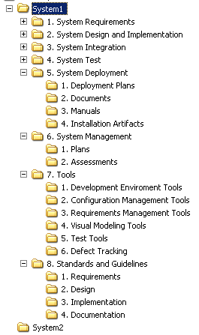
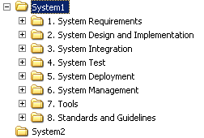
4. Develop System Directory Structure

Slide 30
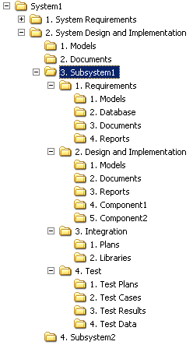
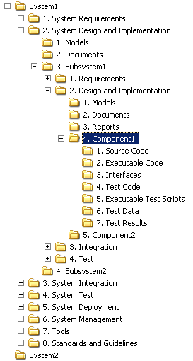
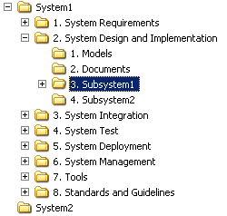
5. Develop Subsystem and Component Directory Structure

Slide 31
6. Identify Baselines
Activities
Identify role and reponsibility of people creating and appoving baseline
Select Configuration Items
Approve
Document the set of configuration items that are contained in a baseline
Outputs
Baselines
Description of baselines
Baseline
Subsystem Baselines
System Baselines
Requirements
Design
Source Code, Executable Code
User Guide
...

Slide 32
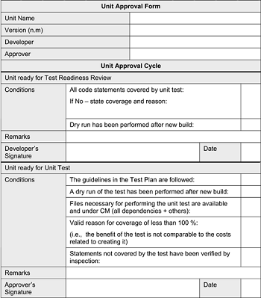
7. Define Item Approval Template [2]
Item approval is evidence that items satisfy the criteria for placing under configuration management.
Content
Configuration item concerned
Dated signatures (electronic or other) by the producer, the person responsible, and the approver
Condition(s) for approval
Related metadata
An item approval will typically be a form; either paper based or electronic.

Slide 33
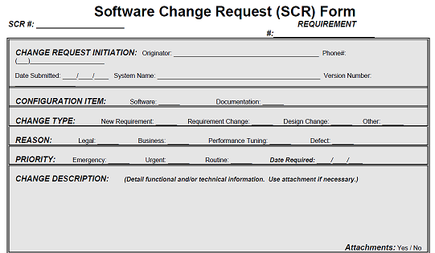
8. Define Change Request Template
A change request is a document containing a call for an adjustment of a system.
A wrong formulation, caught during the review of a document
A coding mistake
An enhancement
A mistake found in the integration test
An inquiry to a helpdesk about a problem in connection with usage of a system
A change required in the code because of an upgrade to a new version of the middleware supporting the system, which may not be backward compatible
Content
The change: identification, identification of the underlying event, configuration item concerned, and priority
Phase information for the change: phase, date and time, name of the person responsible, description

Slide 34
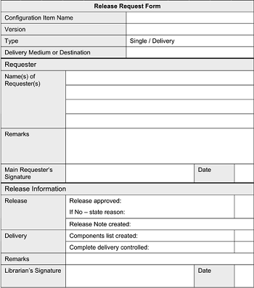
9. Define Release Request Template
A release request is a document defining what is released from the configuration management library, and to whom.
Content
Configuration item concerned
Dated signature(s) by requester or requesters
If desired, dated signature by the person responsible
Reason for release request
Delivery medium and/or destination
A release request may be a form, either paper based or electronic.

Slide 35




10. Establish Communication Tools

Slide 36

Hands-On Communication Tools
Zoom. https://zoom.us/
Skype. https://www.skype.com/en/
Discord. https://discordapp.com
Viber. https://www.viber.com/en/
Telegram. https://web.telegram.org/
Gmail. https://www.google.com/gmail
Outlook. https://outlook.office365.com/mail/
Slack. https://slack.com/

Slide 37
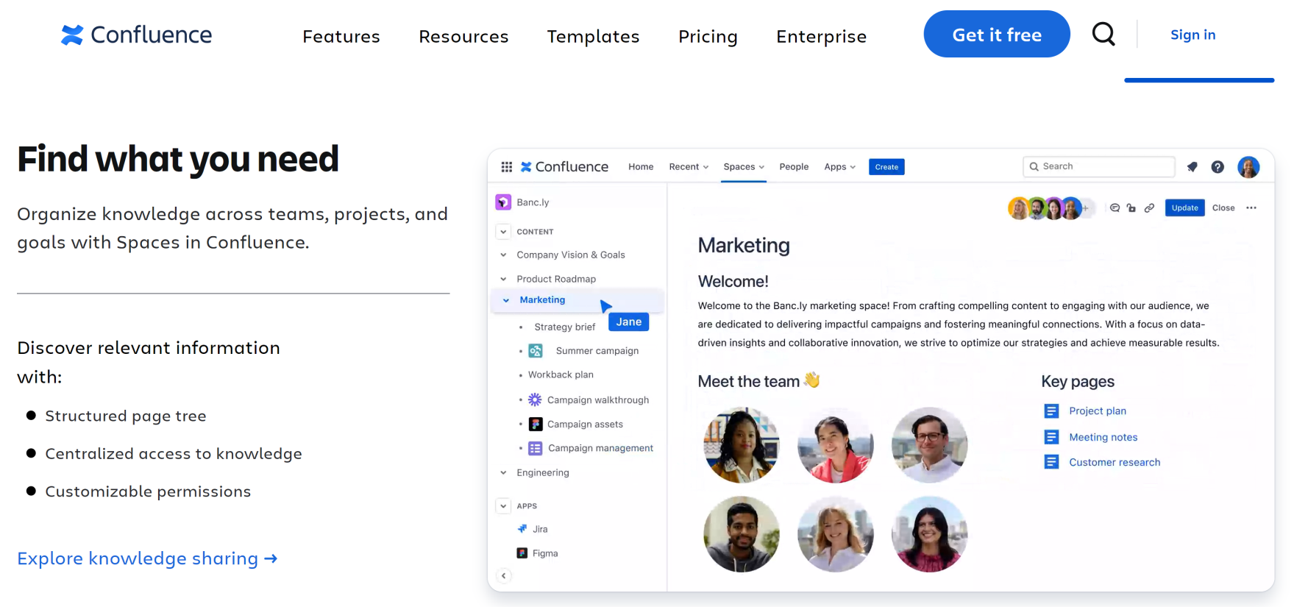
11. Establish Requirements Management Tools

Slide 38
Hands-On Requirements Management Tools
Confluence. https://www.atlassian.com/software/confluence
Google Sheets. https://www.google.com/sheets/about/

Slide 39
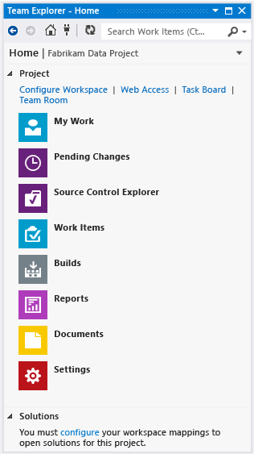
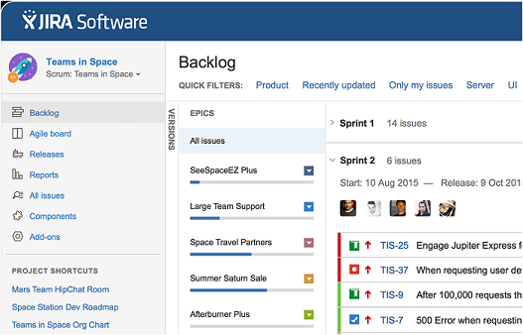
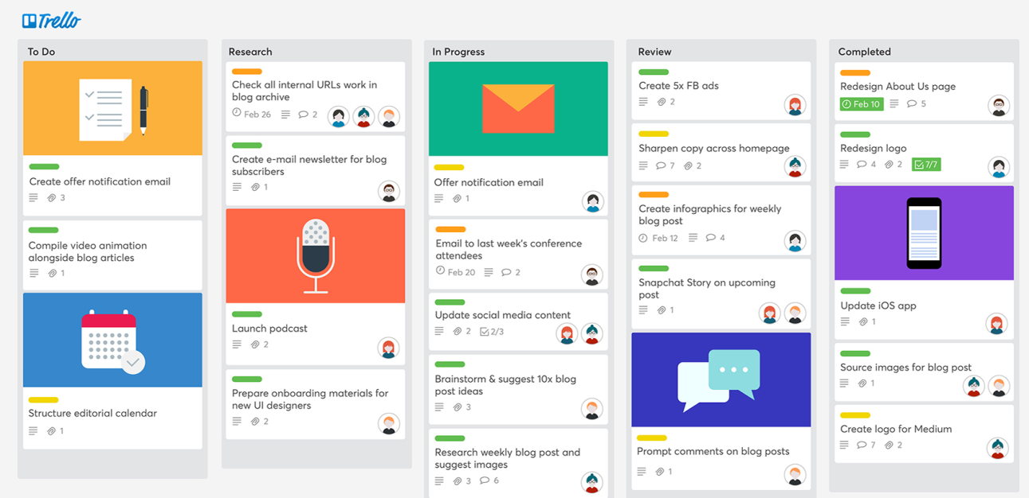
12. Establish Task Tracking Tools

Slide 40
Hands-On Task Tracking Tools
Trello. https://trello.com/
Asana. https://asana.com
Atlassian Cloud. https://www.atlassian.com/software/free
ClickUp. https://app.clickup.com

Slide 41
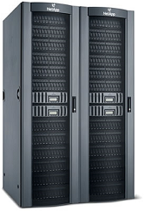





13. Establish Version Control Systems
Ensure that a configuration item will not disappear or be damaged
It can be found at any time and delivered in the condition in which you expect to find it.
Record is kept to indicate who has been given the item or a copy of it.
Storage media
The tools for accessing the configuration system
Procedures

Slide 42



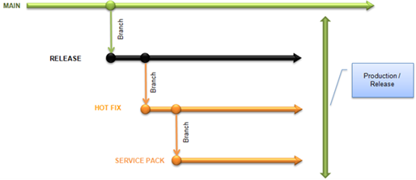
Source Control System
Source Code Sharing
Source Code Reversion
Source Code Branching
and Merging

Slide 43
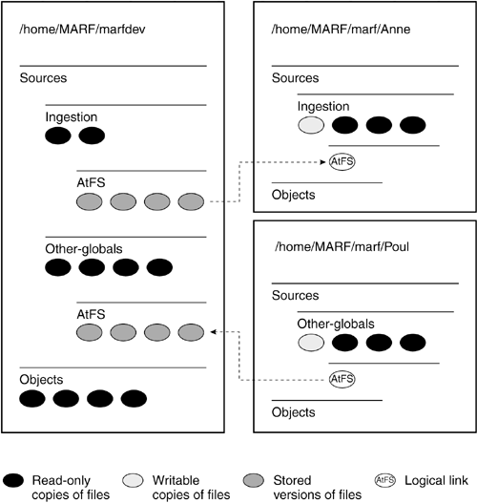
Permissions
The Controlled Library
The Dynamic Library
The Dynamic Library

Slide 44
Hands-On Version Control Systems
GitHub. https://github.com/
GitLab. https://about.gitlab.com/
Git. https://git-scm.com/
Apache Subversion. https://subversion.apache.org/
VisualSVN Server. https://www.visualsvn.com/server/
TortoiseSVN. https://tortoisesvn.net/
Google Docs. https://docs.google.com
Confluence. https://www.atlassian.com/software/confluence

Slide 45
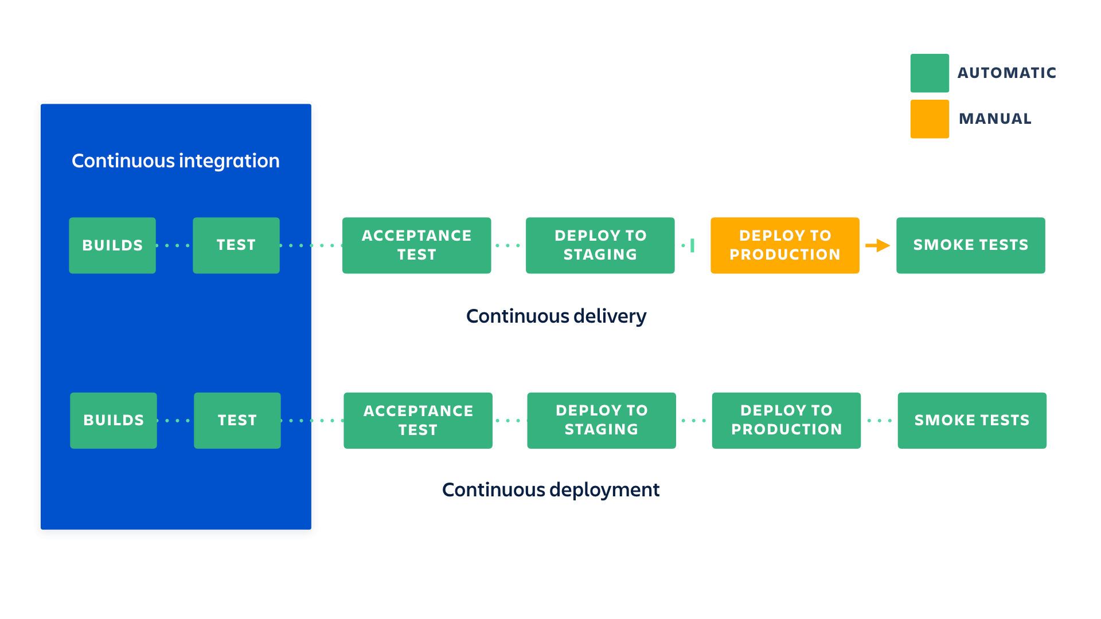
CI/CD Process
https://www.atlassian.com/continuous-delivery/ci-vs-ci-vs-cd
Continuous integration: The developer's changes are validated by creating a build and running automated tests against the build.
Continuous delivery is an extension of continuous integration: on top of having automated your testing, you also have automated your release process and you can deploy your application at any point of time by clicking on a button.
Continuous deployment: Every change that passes all stages of your production pipeline is released to your customers. There's no human intervention, and only a failed test will prevent a new change to be deployed to production.

Slide 46

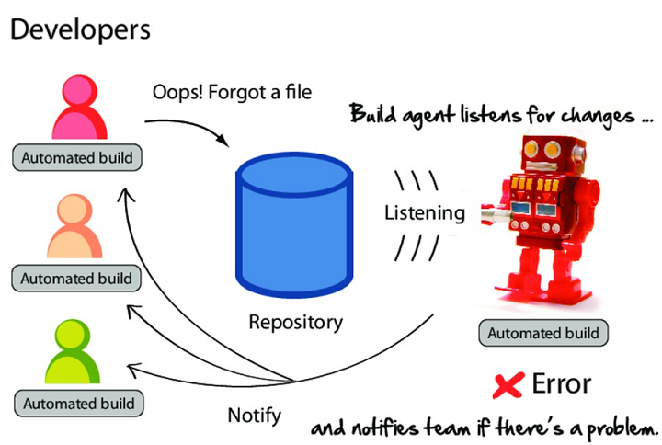



14. Implement Continuous Integration

Slide 47

15. Implement Continuous Deployment

Slide 48
Hands-On CI/CD
GitHub Actions. https://github.com/features/actions
GitLab. https://docs.gitlab.com/ee/ci/
CircleCI. https://circleci.com/docs/getting-started/
Jenkins. https://www.jenkins.io/doc/tutorials/
Xcode Cloud. https://developer.apple.com/xcode-cloud/

Slide 49
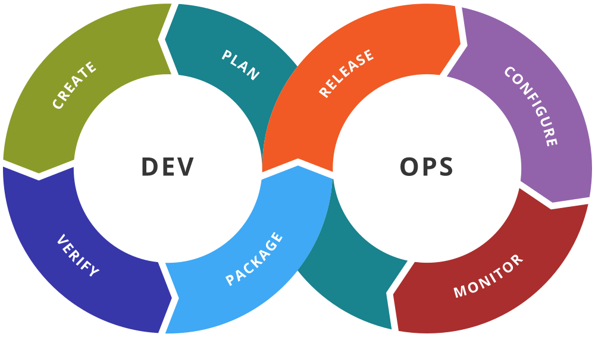
16. Implement DevOps
Infrastructure as code (use scripts to automate tasks whenever possible).
Create configuration setting for enabling/disabling a new feature whenever possible.
Use IF ELSE for enabling or disabling code of the new feature.
Features separation/coupling.
Continuous monitoring.

Slide 50
Hands-On DevOps
Docker https://www.docker.com/
Kubernetes https://kubernetes.io/
Chef https://www.chef.io/
Ansible https://www.ansible.com/
Nagios https://www.nagios.org/

Slide 51
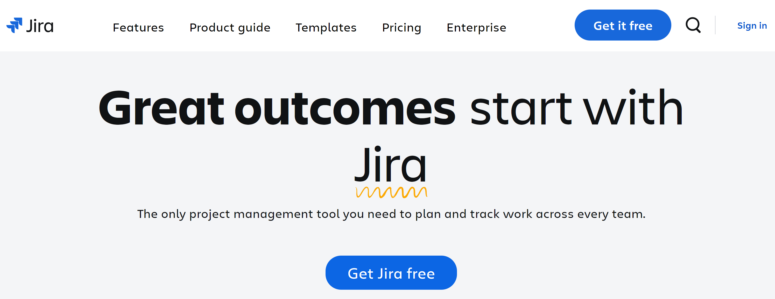
17. Establish Bug Tracking Tools

Slide 52
Hands-On Bug Tracking Tools
Jira. https://www.atlassian.com/software/jira
Bugzilla. https://bugzilla.readthedocs.io/en/latest/installing/
MantisBT. https://mantisbt.org/download.php

Slide 53
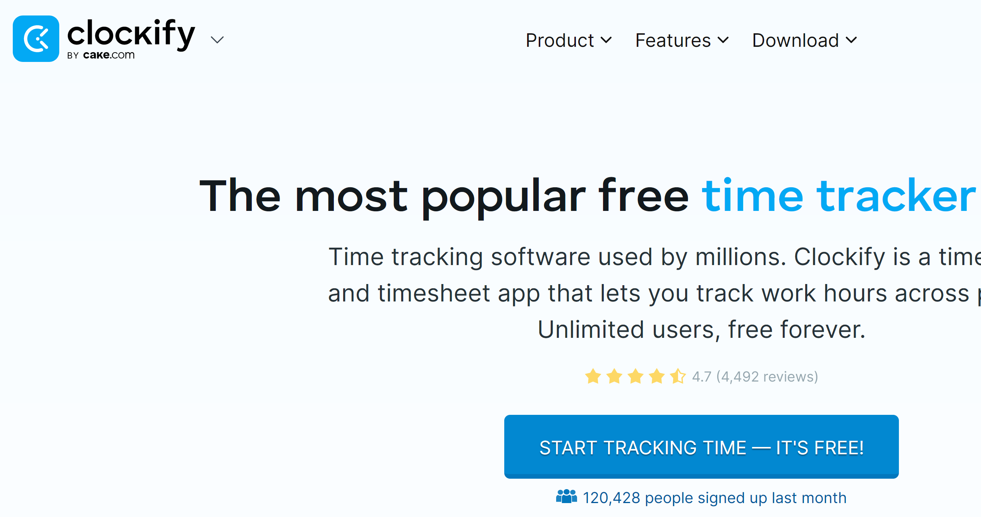

18. Establish Time Tracking Tools

Slide 54
Hands-On Time Tracking Tools
Clockify. https://clockify.me/
Toggl. https://toggl.com/

Slide 55

19. Operate Configuration Management System
Activities:
Establish a mechanism to manage multiple control levels of configuration management.
Store and retrieve configuration items in a configuration management system.
Share and transfer configuration items between control levels within the configuration management system.
Store, update, and retrieve configuration management records.
Outputs: Configuration Management Records
Revision history of configuration items
Change log
Copy of the change requests
Status of configuration items
Differences between baselines

Slide 56
Other Helpful Tools
Screen Capture: https://www.screenpresso.com

Slide 58
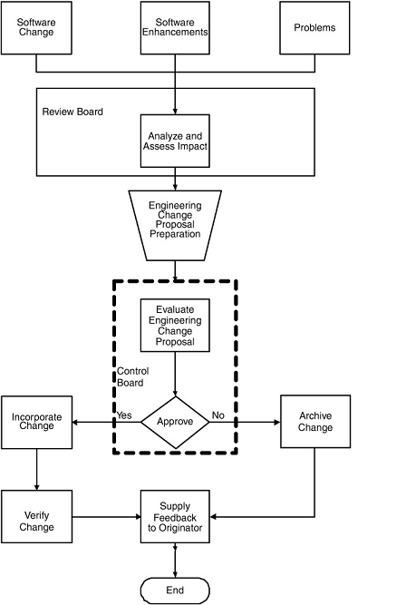
20. Establish Change Control Process
The goal of configuration change control is to establish mechanisms that will help ensure the production of quality software as well as ensure that each version of the software contains all necessary elements, and that all elements in a version will work correctly together.
Defining the change process
Establishing change control policies and procedures
Maintaining baselines
Processing changes
Developing change report forms

Slide 60
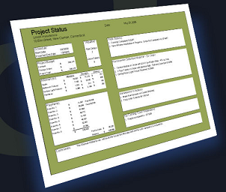
21. Perform Status Reporting
Status reporting makes available, in a useful and readable way, the information necessary to effectively manage a product's development and maintenance.
Why status reporting?
Get information on change decisions
Assist future planning efforts
Review the complete configuration of a product or any of its component parts
Review maintenance information
Review documentation
Review source code
Activities:
List baselines
Hightlight current CIs and changed CIs
List changes

Slide 61

Configuration Audits
Configuration audits confirm that the resulting baselines and documentation conform to a specified standard or requirement.

Slide 62

Functional Configuration Audits
Functional Configuration Audits (FCA) – Audits conducted to verify that the actual performance of the CI meets the requirements stated in its performance specification and to certify that the CI has met those requirements.
Why FCA?
A multi million dollar system is shipped to a customer with three important features missing.
The customer's business is disrupted.
The missing features were clearly specified in the Contract Software Requirements Specification.
The customer successfully sues the developer for damages.

Slide 63

Physical Configuration Audit
Physical Configuration Audit (PCA) – Audits conducted to verify that the related design documentation matches the design of the deliverable CI.
Why PCA?
A steel company installs a complex control system in their rolling mill.
Seven years later the computer hardware platform ceases to be supported by its supplier.
The company initiates a project to refactor the software for a new hardware platform.
The source code on file does not match the executables running on the operational system. Further, the requirements specifications and design descriptions have been lost.

Slide 64

22. Perform Configuration Audits
Assess the integrity of the baselines.
Confirm that the configuration management records correctly identify the configuration items.
Review the structure and integrity of the items in the configuration management system.
Confirm the completeness and correctness of the items in the configuration management system. Completeness and correctness of the content is based on the requirements as stated in the plan and the disposition of approved change requests.
Confirm compliance with applicable configuration management standards and procedures.
Track action items from the audit to closure.
Outputs:
Configuration audit results
Action items

Slide 65
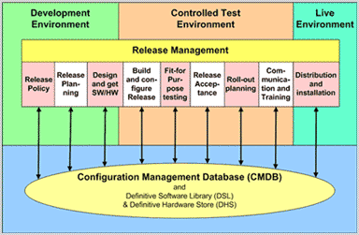
23. Manage Releases
Software release management contains identification, packaging, and delivery of the elements of a product.
Identify baselines.
Create Configuration Status Accounting Reports (CSAR).
Perform PCA, FCA.
Package files and documents.
Receive client’s confirmation.

Slide 66
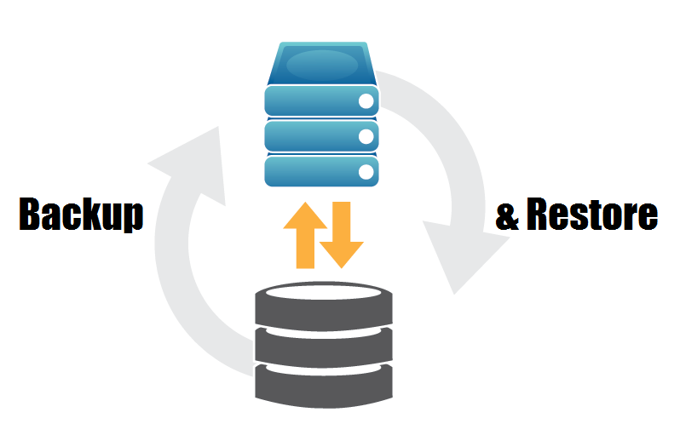
24. Set Up Backup Process
Benefits:
Recovery data when there are problems.
Support version control.

Slide 67
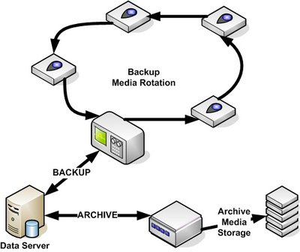
25. Perform Archiving
Data archiving is the process of moving data that is no longer actively used to a separate data storage device for long-term retention.
Data archives consist of older data that is still important and necessary for future reference, as well as data that must be retained for regulatory compliance.
When project is finished:
Archive data of project
Archive or remove paper documents
Clean all information of project

Slide 68
Why CM?
The purpose of configuration management is to establish and maintain the integrity of work products using configuration identification, configuration control, configuration status accounting, and configuration audits.
SCM
Identification
Control
Status Accounting
Audit And Review
Safer
Faster
Better

Slide 70

Configuration Management Roles

Slide 71
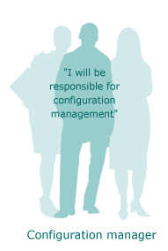
Configuration Manager
The person responsible for configuration management implements, maintains, and improves configuration management within the framework provided by management.
Transforming the company's needs and requirements for configuration management to relevant, practical procedures, resources, and tools
Selecting and testing configuration management tools
Updating information about new versions of existing tools and new tools
Following up on the performance and efficiency of configuration management
Making status reports to management with data analysis and recommendations for improvement

Slide 72
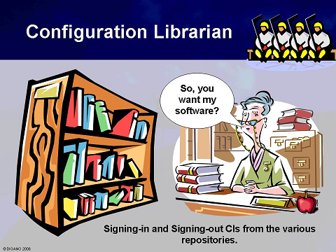
Librarian
Establishing the configuration management library—a controlled master library for storing configuration items
Maintaining and controlling the contents of the library
Communicating contents of the configuration management library
Controlling the configuration management library

Slide 73
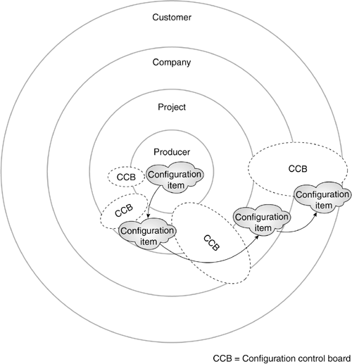
Configuration Control Board
Related People
Analyst
Architect
Developer
Integrator
Tester
Customer Contact
People Being
Resposible For Assets Operation, Process Management Support
Configuration Manager
Librarian
Project Manager
Technical Lead
Test Lead
Quality Engineer

Slide 74

Analyst
Identifying relevant configuration items
Placing relevant items in storage after due approval
Producing appropriate event registrations for the items used in connection with analysis (such as contracts or user requirement specifications)
Extracting related configuration items as the basis for producing analysis objects, such as contracts or user requirement specifications
Getting information about the status and history of these items
Getting trace analysis results toward these items, to ensure the analysis covers all requirements

Slide 75

Architect
Identifying relevant configuration items (design documents)
Placing relevant configuration items in storage after due approval
Producing appropriate event registrations for items used in connection with design work, such as user requirement specifications and software requirements specifications
Extracting related configuration items as the basis for producing design items, such as software requirements specifications
Getting information on the status and history of these items
Getting trace analysis results toward these items, to ensure that the design covers all demands

Slide 76

Developer
Identifying relevant configuration items (source code and object files)
Placing relevant configuration items in storage after due approval
Producing appropriate event registrations for items used in connection with programming, such as requirement specifications or design
Extracting related configuration items as the basis for producing programming objects, such as software requirement specifications and design
Getting information on the status and history of these items
Getting trace analysis results toward these items, to ensure that the code and related objects cover at least the design and possibly also explicitly all software requirements

Slide 77

Integrator
Identifying relevant configuration items (build scripts and, not least, deliveries in the form of larger and larger subsystems)
Placing relevant items in storage after due approval
Producing appropriate event registrations for items used in connection with integration, such as source code
Extracting related configuration items as a basis for integration, such as architectural design, development plans, and test plans
Extracting configuration items from which their own items must be produced
Getting information on the status and history of these items

Slide 78
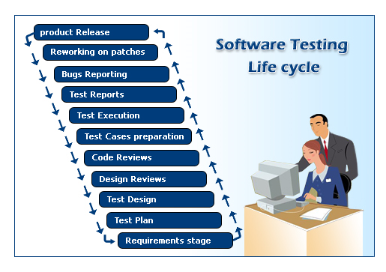
Tester
Identifying relevant configuration items (test plans, descriptions, scripts, and data, and releases for an entire test, including test environment)
Placing relevant items in storage after appropriate approval
Producing appropriate event registrations for items used in connection with testing, such as source code or (sub)systems
Extracting related configuration items as the basis for testing, such as individual configuration items or, more important, deliveries in terms of integrated (sub)systems
Getting information on the status and history of these items
Getting information about relevant event registrations and their progress

Slide 79

Project Manager
Producing and updating a configuration management plan in agreement with the overall project plan
Identifying necessary configuration management roles for the project
Assigning responsibility for configuration management activities in accordance with identified roles
Allocating resources for configuration management
Following up on planned configuration management activities
Status reports from the configuration management system concerning configuration items
Information about event registrations and their progress
Measurements produced from the configuration management system, concerning both configuration management itself and other processes

Slide 80


Customer And Customer Contact
Participating in one or more configuration control boards
Creating event registrations
Approving produced configuration items
Producing documentation to fulfill the customer's configuration management requirements
Receiving and possibly performing quality assurance on deliveries from the customer, such as user requirement specifications, and possibly performing internal configuration management on them
Possibly forwarding event registrations to the customer
Receiving event registrations from the customer, such as in connection with a review of documentation or with early user or acceptance tests

Slide 81


Subcontractor and Subcontractor Contact
Study, understand, and use the contractor's configuration management system
Deliver event registrations or change requests (depending on the form of cooperation) to the subcontractor

Slide 83

Configuration Management Plan

Slide 84
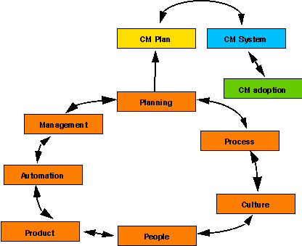

Configuration Management Plan
A plan describes what you will do and a procedure describes how it will be done.
The plan documents the CM process and as such acts as the tool used to gain project and management support for the process.
CM plan is the actual plan that will be implemented to address the CM needs. It gives all the procedures, policies, schedules, responsibilities, etc.
The plan forces you to define and describe the process.
The plan causes you to think about what you will do and how you will do it.
The plan serves as a contract vehicle for the project.

Slide 85




Interviews (I)
Should CM procedures be part of the CM plan or be separate?
Do standards aid in the development of a CM plan?
Is the CM plan updated throughout the project life cycle?
Was the CM plan used after it was developed? If so, by whom and how?

Slide 86



Interviews (II)
Is there a need for a CM plan at the company/division level as well as at the project level?
Are there significant differences between a CM plan written for a development project and a CM plan written for a maintenance project?
Are there significant differences between a CM plan written for hardware versus software?

Slide 87



Interviews (III)
Are there significant differences between a CM plan written for a large project versus a small project?
What makes a CM plan hard to write?
How to perform CM?
What processes you will implement?
Lack of a defined CM process makes it impossible to write the CM plan
Would having an automated tool to assist in developing a CM plan help?

Slide 88

Outline of a Model CM Plan (I)
1.0 INTRODUCTION
1.1 Purpose 1.2 Scope 1.3 Definitions 1.4 References 1.5 Tailoring
2.0 SOFTWARE CONFIGURATION MANAGEMENT
2.1 SCM organization
2.2 SCM responsibilities
2.3 Relationship of CM to the software process life cycle
2.3.1 Interfaces to other organizations on the project
2.3.2 Other project organizations CM responsibilities

Slide 89

Outline of a Model CM Plan (II)
3.0 SOFTWARE CONFIGURATION MANAGEMENT ACTIVITIES
3.1 Configuration Identification
3.1.1 Specification Identification
Labeling and numbering scheme for documents and files
How identification between documents and files relate
Description of identification tracking scheme
When a document/file identification number enters controlled status
How the identification scheme addresses versions and releases
How the identification scheme addresses hardware, application software system software, COTS products, support software (e.g., test data and files), etc.
3.1.2 Change Control Form Identification
Numbering scheme for each of the forms used

Slide 90


Outline of a Model CM Plan (III)
3.1.3 Project Baselines
Identify various baselines for the project
For each baseline created provide the following information:
How and when it is created
Who authorizes and who verifies it
The purpose
What goes into it (software and documentation)
3.1.4 Library
Identification and control mechanisms used
Number of libraries and the types
Backup and disaster plans and procedures
Recovery process for any type of loss
Retention policies and procedures
What needs to be retained, for who, and for how long
How is the information retained (on-line, off-line, media type and format)

Slide 91

Outline of a Model CM Plan (IV)
3.2 Configuration Control
3.2.1 Procedures for changing baselines (procedures may vary with each baseline)
3.2.2 Procedures for processing change requests and approvals-change classification scheme
o Change reporting documentation
o Change control flow diagram
3.2.3 Organizations assigned responsibilities for change control
3.2.4 Change Control Boards (CCBs) - describe and provide
the following information for each:
o Charter
o Members
o Role
o Procedures
o Approval mechanisms
3.2.5 Interfaces, overall hierarchy, and
the responsibility for communication between multiple CCBs, when applicable
3.2.6 Level of control - identify how it will change throughout the life cycle, when applicable
3.2.7 Document revisions - how they will be handled
3.2.8 Automated tools used to perform change control

Slide 92

Outline of a Model CM Plan (V)
3.3 Configuration Status Accounting
3.3.1 Storage, handling and release
of project media
3.3.2 Types of information needed
to be reported and the control
over this information that is needed
3.3.3 Reports to be produced
(e.g., management reports, QA reports,
CCB reports) and who the audience
is for each and the information needed
to produce each report
3.3.4 Release process, to include the following information:
o What is in the release
o Who the release is being provided to and when
o The media the release is on
o Any known problems in the release
o Any known fixes in the release
o Installation instructions
3.3.5 Document status accounting and change management status accounting that needs to occur

Slide 93

Outline of a Model CM Plan (VI)
3.4 Configuration Auditing
3.4.1 Number of audits to be done and when
they will be done (internal audits as well as
configuration audits); for each audit provide the
following:
o Which baseline it is tied to, if applicable
o Who performs the audit
o What is audited
o What is the CM role in the audit, and what
are the roles of other organizations in the audit
o How formal is the audit
3.4.3 All reviews that CM supports; for each
provide the following:
o The materials to be reviewed
o CM responsibility in the review and the responsibilities of other organizations

Slide 94


Outline of a Model CM Plan (VII)
4.0 CM MILESTONES
Define all CM project milestones (e.g., baselines, reviews, audits)
Describe how the CM milestones tie into the software development process
Identify what the criteria are for reaching each milestone
5.0 TRAINING
Identify the kinds and amounts of
training (e.g., orientation, tools)
6.0 SUBCONTRACTOR/VENDOR SUPPORT
Describe any subcontractor and/or
vendor support and interfacing, if applicable

Slide 96

Configuration Management Solution

Slide 97

ISO/IEC 15504 (SPICE) [4]
SPICE: Software Process Improvement and Capability Determination
Work product management means that for any given process area to obtain level 2, all relevant work products from the performance of the process area must be placed under configuration management.

Slide 98

Goals
A configuration management strategy will be developed.
All items generated by the process or project will be identified, defined, and base-lined.
Modifications and releases of the items will be controlled.
The status of the items and modification requests will be recorded and reported.
The completeness and consistency of the items will be ensured.
Storage, handling, and delivery of the items will be controlled.

Slide 99
Practices
Develop configuration management strategy
Establish configuration management system
Identify configuration items
Maintain configuration item description
Manage changes
Manage product releases
Maintain configuration item history
Report configuration status
Manage the release and delivery of configuration items

Slide 100

Standard Definition of CM
Standard definition (IEEE 729-1983)
Identification
identifying components, structure
Control
controlling releases and changes
Status accounting
recording, reporting status
Audit and review
validating completeness
What version of the file is this?
What changes went into the latest version of this product?
How many files were affected by fixing this one bug?
Are all the correct versions of files used in this current release?

Slide 101
Broaden Definition of CM
Based on existing CM systems, broaden definition
Manufacture
managing construction, building
What versions of files and tools were used to generate this latest release?
Process modelling
ensuring life-cycle model
Were all the files tested and checked for quality before being released to the customer?
Team work
controlling team interactions
Were all the locally made changes of the programmers merged into the last release of the product?

Slide 102
Effects
CM
Software development environment
Software process model
Quality of software product
User’s organization

Slide 103
CM Solution
Planning
Capturing all the important aspects about doing CM
Defining a process
Capturing all the steps, tasks, and associated policies and procedures needed for doing CM
Dealing with people
Catering for different user roles that exist in the organization
Automating
support
Helping with maintaining integrity and quality of the process and product
Making management decisions
Deciding when to start using CM, whether to buy or build a CM system and how to best perform technology transition for the CM system

Slide 104
Perspectives
Corporate
organization’s view and process of CM
Project
each project group may use a different CM system
Developer
entails the specific functionality provided by a CM system
Application
how CM is applied to a specific problem

Slide 105
In-house
Manual procedures and policies
Compiling code
Tracking
and dealing with bugs
Version control
Third-party solutions?

Slide 106
CM Technology
CM concepts
Management
Political
Process orientation
Standardization

Slide 107
CM Services Model
The Power of Information
Workflow
Automation
A Branch too Far

Slide 108

Further Reading
Len Bass, Ingo Weber and Liming Zhu (2015). DevOps - A Software Architect's Perspective. Pearson Education.
Gene Kim et al. (2016). The DevOps Handbook. IT Revolution.
Julien Vehent (2018). Securing DevOps. Manning Publications.

Slide 109

Thank You & See You Again

